Slide 1
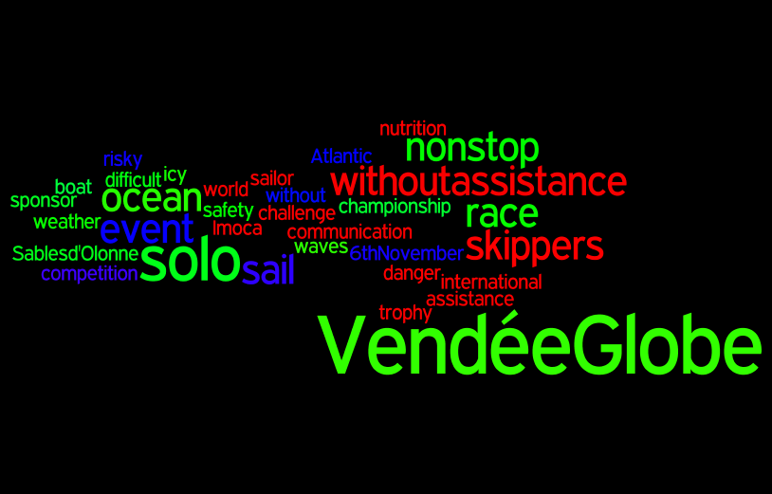

Slide 2
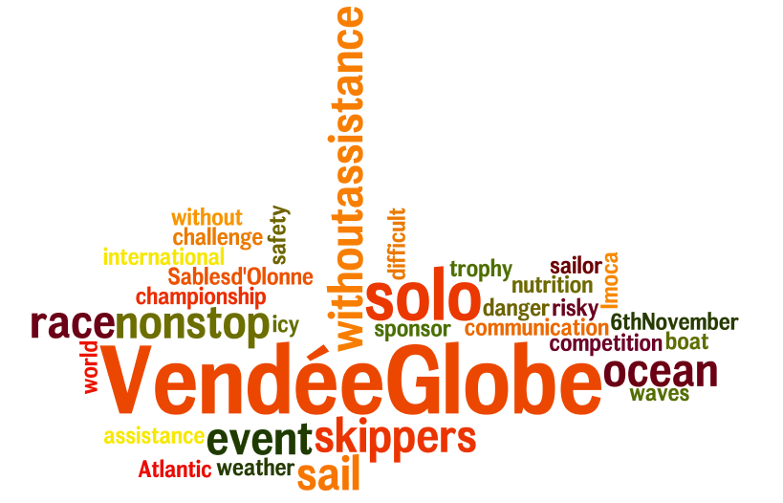

Slide 3
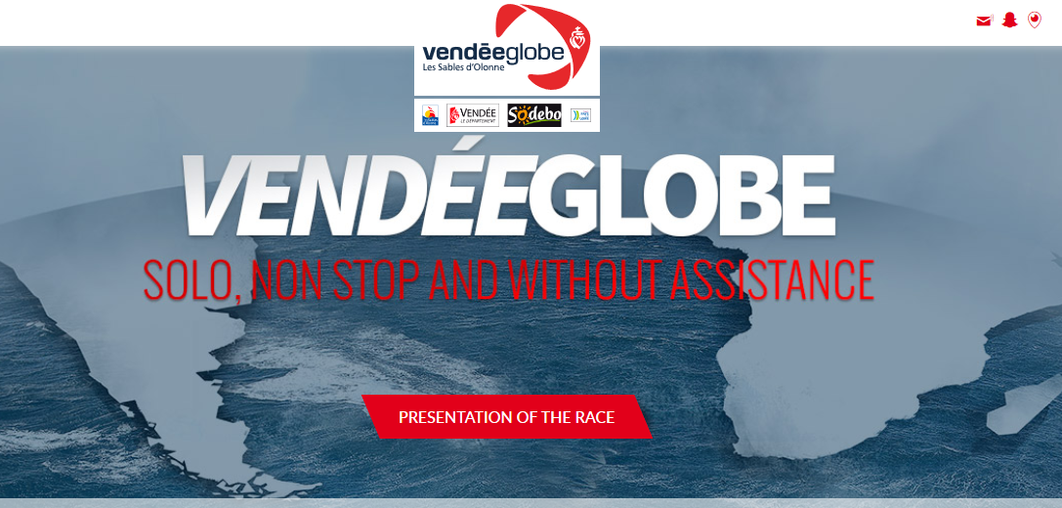

Slide 4
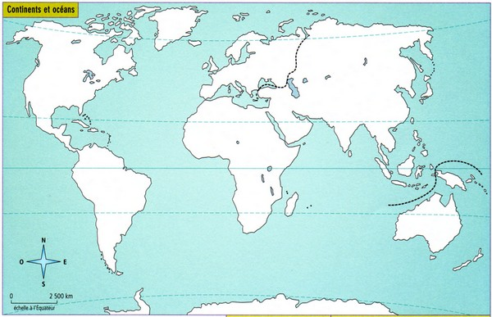
clic

Slide 5
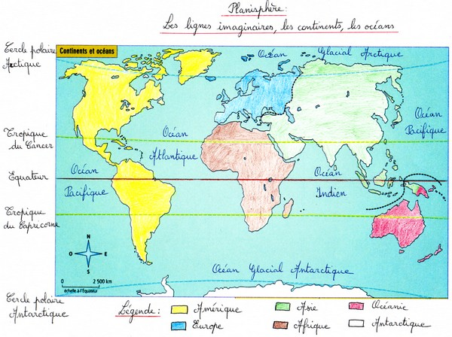

Slide 6
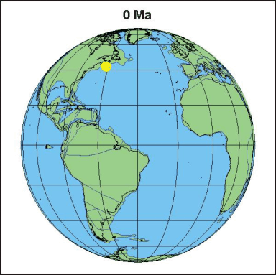
HOW MANY CONTINENTS ARE THERE?
THERE ARE….

Slide 7
HOW MANY OCEANS ARE THERE?
THERE ARE….

Slide 8
WHAT ARE IMAGINARY LINES AROUND THE WORLD CALLED?
THERE IS….

Slide 9
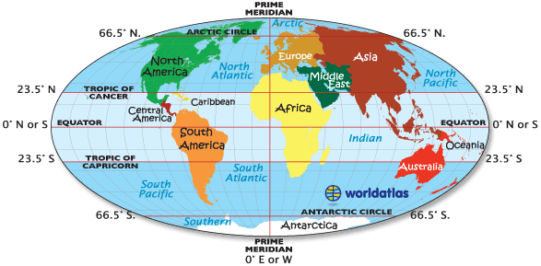
http://slideplayer.com/slide/5862743/

Slide 10
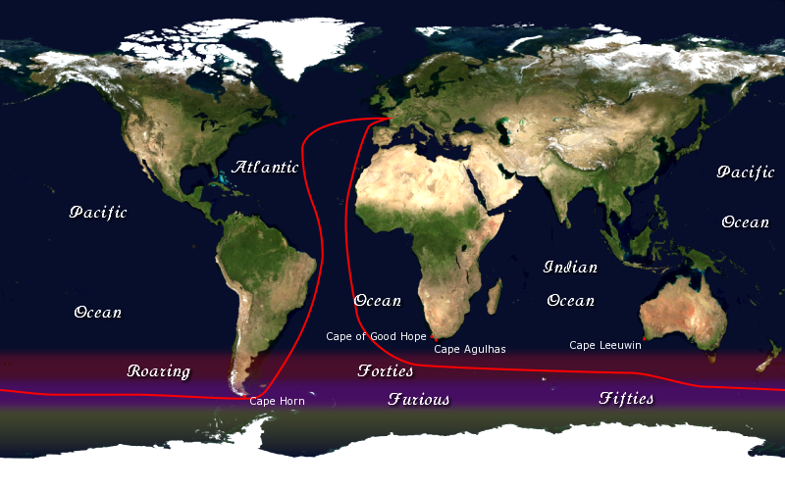
The route of the Vendée Globe round-the-world yacht race

Slide 11
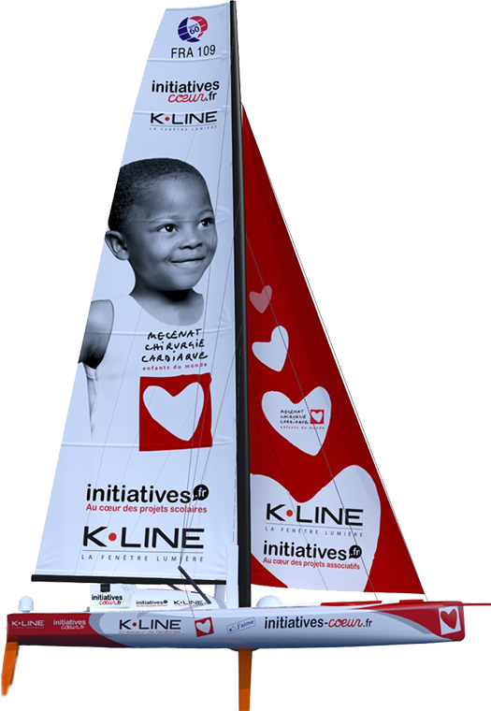
IMOCA monohull
INITIATIVES COEUR

Slide 12
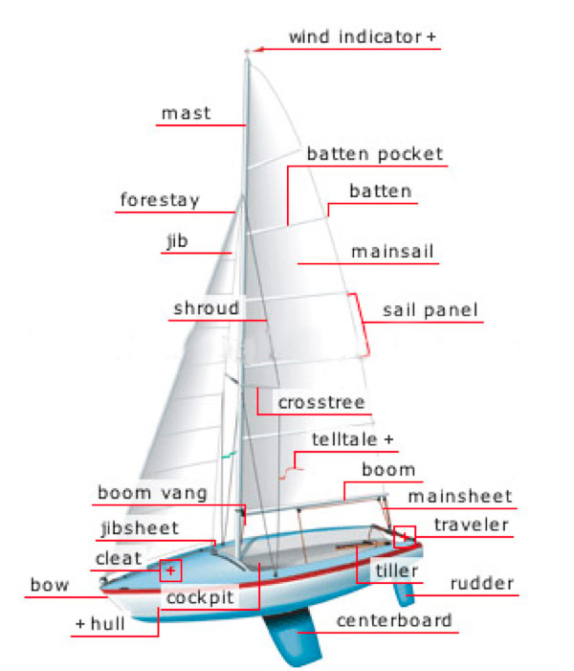
http://visual.merriam-webster.com/sports-games/aquatic-nautical-sports/sailing/sailboat.php

Slide 13
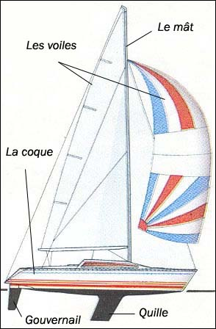

Slide 14
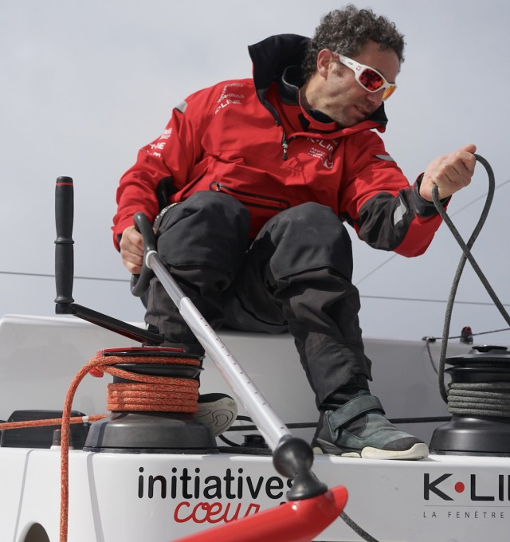
Tanguy de Lamotte

Slide 15
IMOCA monohull
INITIATIVES COEUR
The boat’s previous names: Akena Vérandas, PRB
Designer: Bruce Farr
Chantier : CDK
Launch Date: 01 September 2006
Length: 18,28 m
Beam: 5,85 m
Draught: 4,50 m
Displacement (weight): 8,5 tonnes
Mast height: 28,10 m
Keel blade: Acier
Upwind sail area: 300 m²
Downwind sail area: 500 m²

Slide 16
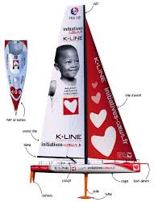
Initiatives-Coeur
The Initiatives-Coeur sailboat skippered by Tanguy de Lamotte engages in ocean races to save children. Every race is an opportunity to raise awareness and during which the two main sponsors of the ship K.line and INITIATIVES finance with their donations, children's operations with serious heart conditions.
www.initiatives-coeur.fr

Slide 17
Practical information
Dates, opening times and venue
Dates:
Vendee Globe Village opening: from Saturday, 15th October 2016 to Sunday, 6th November 2016.
Start of the race: Sunday, 6th November 2016.
Opening times:
Everyday from 10 am to 8 pm.
Late night on Saturday, 15th, 22nd, 29th October, 5th November 2016, show open until 10 pm.
Vendée Globe Village special opening time : on Sunday 6th November, from 8 am to 8 pm. Price:

Slide 18
Price:
Free entrance
http://www.vendee-tourism.co.uk

